Slide 1

Interval Consensus in Network
Chengrui Zhang
2019233183

Slide 2
Outline
1. Introduction
2. Interval Consensus in Deterministic
Network [1]
3. Interval Consensus in Random Network [2]
4. Experiment
5. Comment
[1] Fontan A, Shi G, Hu X, et al. Interval Consensus: a novel class of constrained consensus problems for multiagent networks[C]//2017 IEEE 56th Annual Conference on Decision and Control (CDC). IEEE, 2017: 4155-4160.
[2] Fu W, Qin J, Wu J, et al. Interval consensus over random networks[J]. Automatica, 2020, 111: 108603.

Slide 3

1. Introduction
Consensus Problem:
Goal: Achieve an agreement among a group of agents in a distributed manner.
Example: Formation control of mobile robots → Alignment [3]
Limitation:
An agent has no authority to veto certain values of consensus → add state constraint to the consensus problem
Consensus Problem with constrains:
Optimization algorithms, Projection-based methods etc. to achieve consensus while respecting the positivity of the state variables [1]
[1] Fontan A, Shi G, Hu X, et al. Interval Consensus: a novel class of constrained consensus problems for multiagent networks[C]//2017 IEEE 56th Annual Conference on Decision and Control (CDC). IEEE, 2017: 4155-4160.
[3] Zhiyun Lin, M. Broucke and B. Francis, "Local control strategies for groups of mobile autonomous agents," in IEEE Transactions on Automatic Control, vol. 49, no. 4, pp. 622-629, April 2004, doi: 10.1109/TAC.2004.825639.
Notes:
机器人通过交互排成一列，个体没有控制一致性的权限，
每一个个体都有限制的情况下的一致性

Slide 4
Outline
1. Introduction
2. Interval Consensus in Deterministic
Network
3. Interval Consensus in Random Network
4. Experiment
5. Comment
[1] Fontan A, Shi G, Hu X, et al. Interval Consensus: a novel class of constrained consensus problems for multiagent networks[C]//2017 IEEE 56th Annual Conference on Decision and Control (CDC). IEEE, 2017: 4155-4160.
[2] Fu W, Qin J, Wu J, et al. Interval consensus over random networks[J]. Automatica, 2020, 111: 108603.

Slide 5
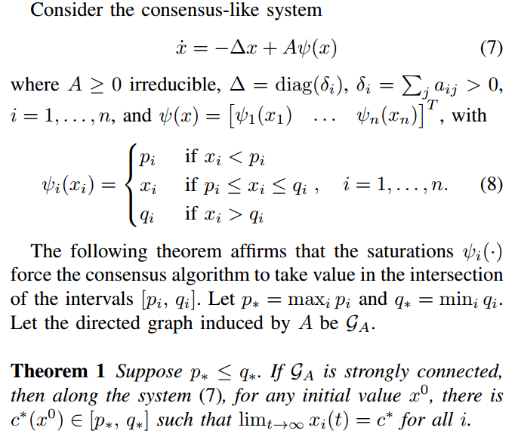
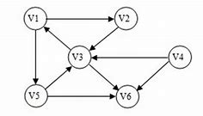
2. Interval Consensus in Deterministic Network
Interval Consensus:
Goal: give to each agent the possibility of limiting the interval of values in which a consensus value can be accepted. [1]
Assumption:
Graph of interactions is directed and strongly connected,
The intervals allowed by the agents have a nonempty intersection
[1] Fontan A, Shi G, Hu X, et al. Interval Consensus: a novel class of constrained consensus problems for multiagent networks[C]//2017 IEEE 56th Annual Conference on Decision and Control (CDC). IEEE, 2017: 4155-4160.
Notes:
每一个节点都有通过自身的限制来限制整体的一致性的可能
A是构成有向强连通图的矩阵 Δ是输入直该节点的权重之和， psai是每一个节点向外输出的限定范围
理论: 对于这样的情况，一定限制在这个范围内

Slide 6





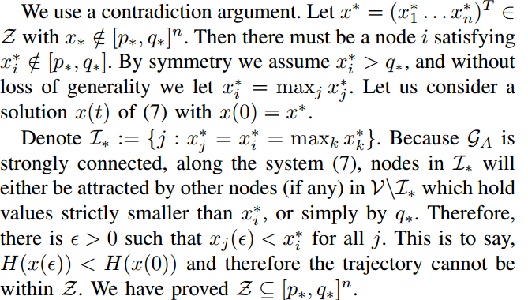


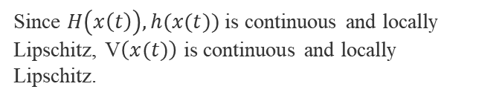
2.1 Derivation—Step 1, 2
Step 1
Step 2
When this graph is strongly connected, the Z will belong to:
Since $H\left(x\left(t\right)\right), h(x(t))$ is continuous and locally Lipschitz, V$\left(x(t)\right)$ is continuous and locally Lipschitz.
[1] Fontan A, Shi G, Hu X, et al. Interval Consensus: a novel class of constrained consensus problems for multiagent networks[C]//2017 IEEE 56th Annual Conference on Decision and Control (CDC). IEEE, 2017: 4155-4160.
Notes:
分为四个阶段，前两个阶段是lasalle证明收敛性
Step 1说明这样构建的V(x(t))一定是导数非正且满足连续和局部lip
Step 2说明满足导数为0的点一定在交集内

Slide 7
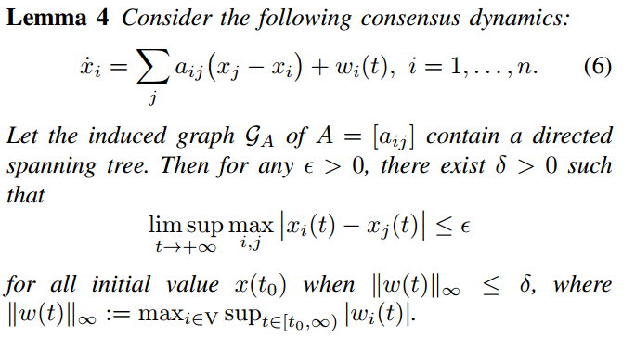



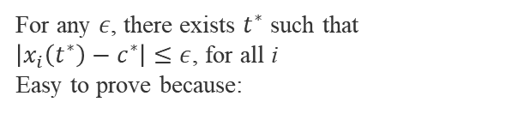
2.1 Derivation—Step 3, 4
Step 3
Step 4
For any $ε$, there exists $t^{∗}$ such that $\left|x_{i}\left(t^{∗}\right)−c^{∗}\right|≤ε$, for all i
Easy to prove because:
Conclusion：
Proof of this theorem is the combination of Lasalle principle and the consensus in Lemma 4.
Lasalle → converge and limitation
Lemma 4 → consensus of each node.
All the node will converge to a consensus value when t → ∞.
[1] Fontan A, Shi G, Hu X, et al. Interval Consensus: a novel class of constrained consensus problems for multiagent networks[C]//2017 IEEE 56th Annual Conference on Decision and Control (CDC). IEEE, 2017: 4155-4160.
Notes:
后两个阶段证明一致性
通过对x导数的拆解使其满足lemma 4的条件，证明最终会达到一致

Slide 8
Outline
1. Introduction
2. Interval Consensus in Deterministic
Network
3. Interval Consensus in Random Network
4. Experiment
5. Comment
[1] Fontan A, Shi G, Hu X, et al. Interval Consensus: a novel class of constrained consensus problems for multiagent networks[C]//2017 IEEE 56th Annual Conference on Decision and Control (CDC). IEEE, 2017: 4155-4160.
[2] Fu W, Qin J, Wu J, et al. Interval consensus over random networks[J]. Automatica, 2020, 111: 108603.

Slide 9
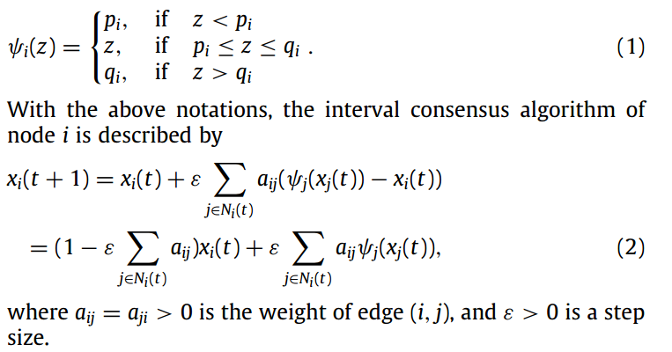
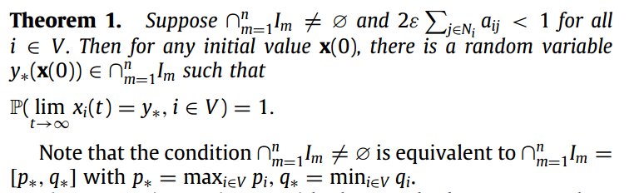
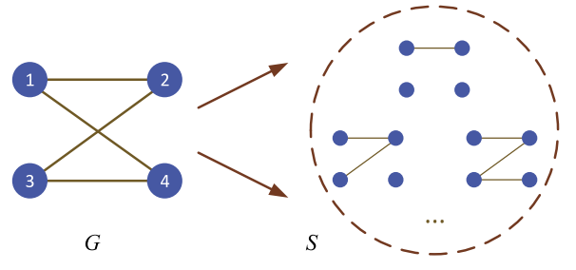
3. Interval Consensus in Random Network [2]
Interval Consensus:
Goal: give to each agent the possibility of limiting the interval of values in which a consensus value can be accepted. [1]
[1] Fontan A, Shi G, Hu X, et al. Interval Consensus: a novel class of constrained consensus problems for multiagent networks[C]//2017 IEEE 56th Annual Conference on Decision and Control (CDC). IEEE, 2017: 4155-4160.
[2] Fu W, Qin J, Wu J, et al. Interval consensus over random networks[J]. Automatica, 2020, 111: 108603.
Notes:
介绍随机网络 无向连通图 目标还是不变
关注不同： 离散（Laplacian matrix拆开了），对权重的限制，概率

Slide 10
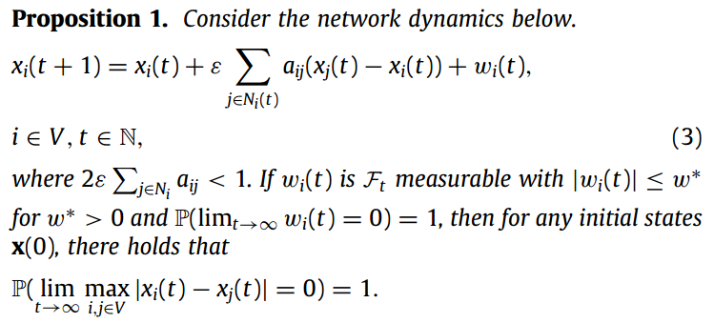
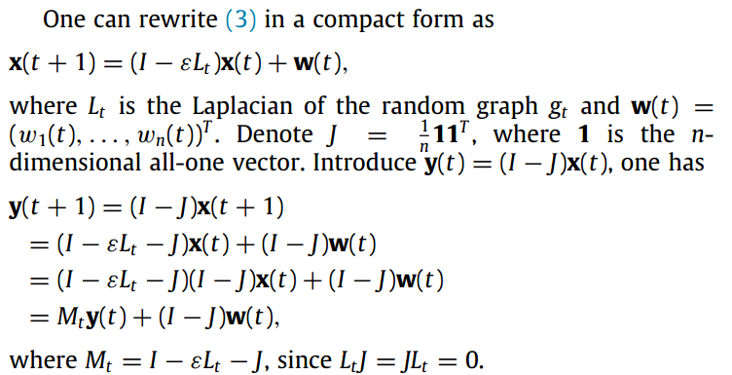

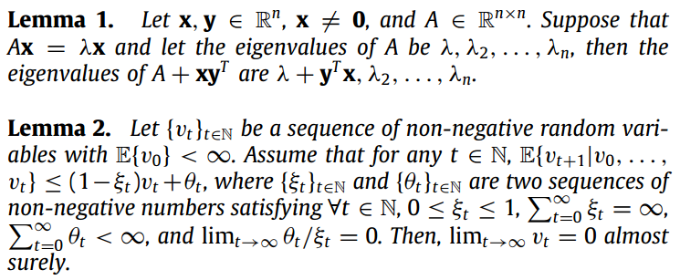
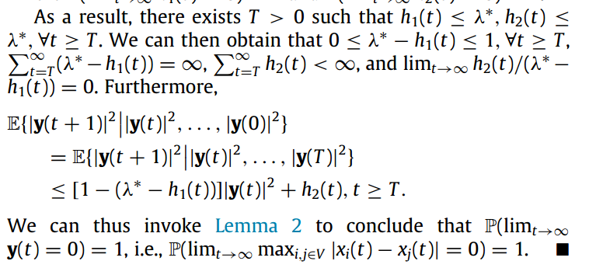
3.1 Derivation—Consensus
[2] Fu W, Qin J, Wu J, et al. Interval consensus over random networks[J]. Automatica, 2020, 111: 108603.
Notes:
证明一致性 主要运用的是lemma，表示。。。
凑出一个和x(t)有关的y(t)使得通过lemma 1和lemma 3，y(t+1)^2可以满足lemma2，也即极限为0
之后讲y(t)用x(t)表示，

Slide 11
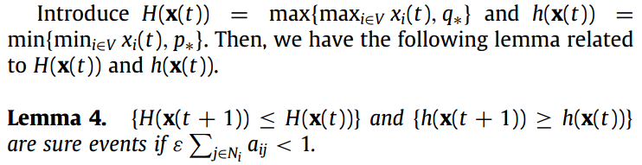
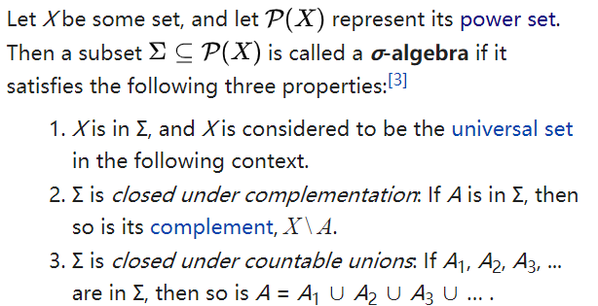

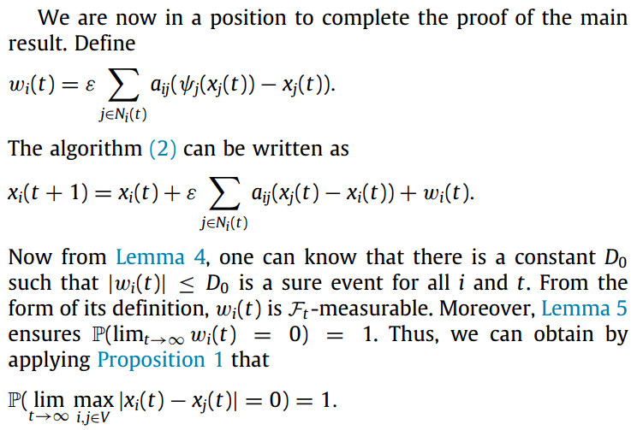
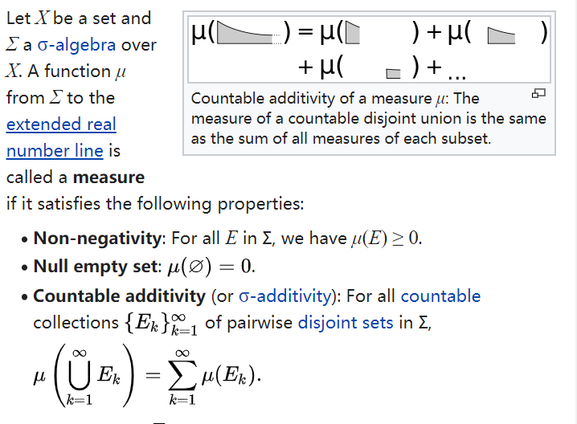


3.1 Derivation—Convergence
$σ$-algebra [5]
Measure[6]
$$\dot{x}$$
[2] Fu W, Qin J, Wu J, et al. Interval consensus over random networks[J]. Automatica, 2020, 111: 108603.
[5] https://en.wikipedia.org/wiki/%CE%A3-algebra
[6] https://en.wikipedia.org/wiki/Measure_(mathematics)#Definition
Notes:
Lemma 4 说明在。。的情况下，H(x)不增 h(x)不减
Lemma 5 结合Lemma 4说明H(x),h(x)最终会收敛到交集之内
根据以上证明的，可以得出离散的表达式可以拆成。。加上一个测度，注意这个测度和连续的是一致的
因为这个测度满足以上引理，命题的条件，所以原方程证明出收敛且在区间内

Slide 12
Outline
1. Introduction
2. Interval Consensus in Deterministic
Network
3. Interval Consensus in Random Network
4. Experiment
5. Comment
[1] Fontan A, Shi G, Hu X, et al. Interval Consensus: a novel class of constrained consensus problems for multiagent networks[C]//2017 IEEE 56th Annual Conference on Decision and Control (CDC). IEEE, 2017: 4155-4160.
[2] Fu W, Qin J, Wu J, et al. Interval consensus over random networks[J]. Automatica, 2020, 111: 108603.

Slide 13
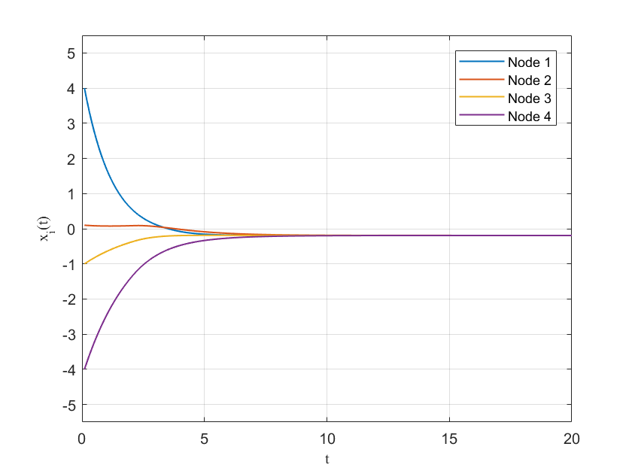
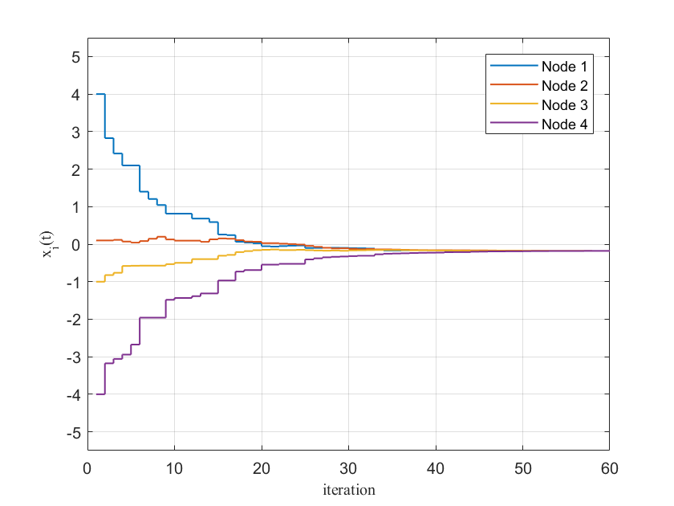
4. Experiment
Common Interval $∈[−0.5, 0.2]$
Deterministic [1]
Random [2]
[1] Fontan A, Shi G, Hu X, et al. Interval Consensus: a novel class of constrained consensus problems for multiagent networks[C]//2017 IEEE 56th Annual Conference on Decision and Control (CDC). IEEE, 2017: 4155-4160.
[2] Fu W, Qin J, Wu J, et al. Interval consensus over random networks[J]. Automatica, 2020, 111: 108603.

Slide 14
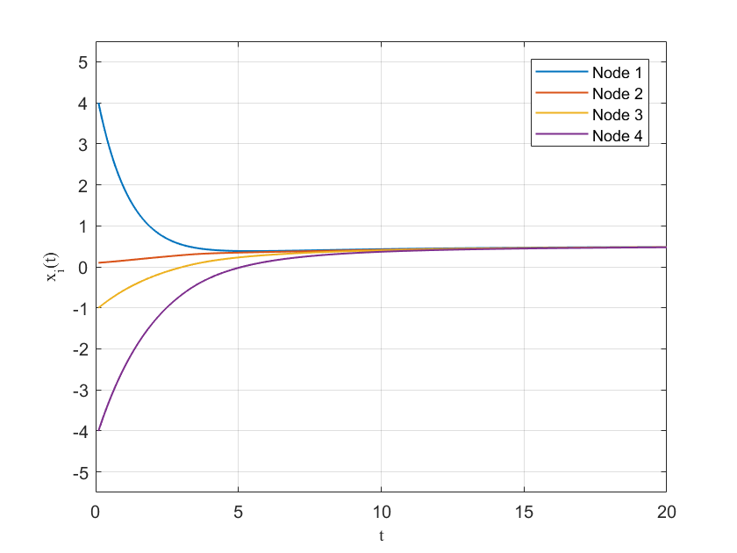
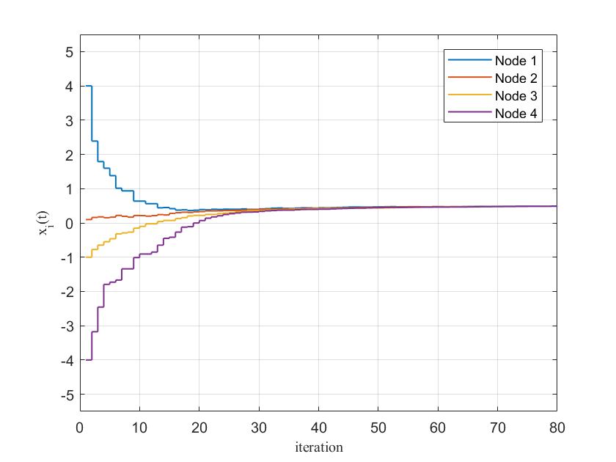
4. Experiment
Common Interval $=0.5$
Deterministic [1]
Random [2]
[1] Fontan A, Shi G, Hu X, et al. Interval Consensus: a novel class of constrained consensus problems for multiagent networks[C]//2017 IEEE 56th Annual Conference on Decision and Control (CDC). IEEE, 2017: 4155-4160.
[2] Fu W, Qin J, Wu J, et al. Interval consensus over random networks[J]. Automatica, 2020, 111: 108603.

Slide 15
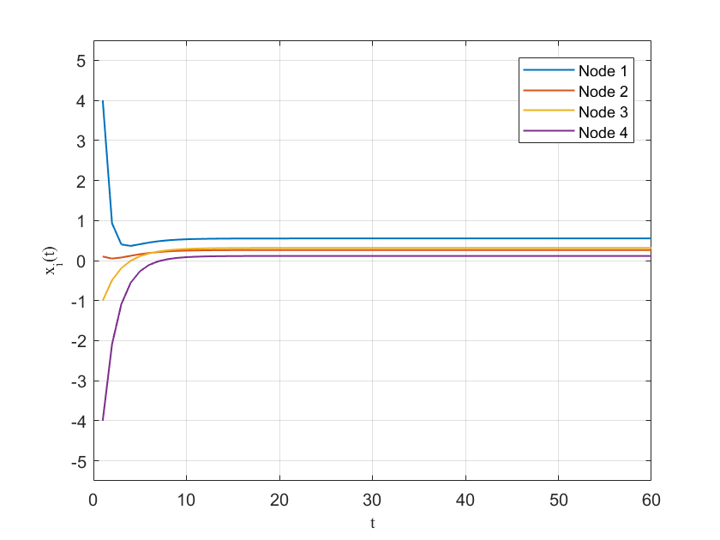
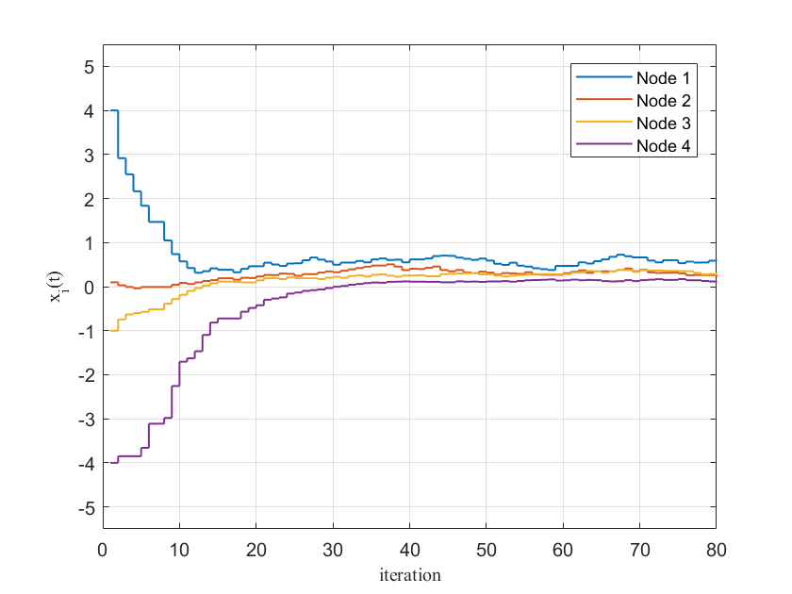
4. Experiment
Common Interval $∈∅$
Deterministic [4]
Random [2]
[2] Fu W, Qin J, Wu J, et al. Interval consensus over random networks[J]. Automatica, 2020, 111: 108603.
[4] Fontan A, Shi G, Hu X, et al. Interval Consensus for Multiagent Networks[J]. IEEE Transactions on Automatic Control, 2019.

Slide 16
Outline
1. Introduction
2. Interval Consensus in Deterministic
Network
3. Interval Consensus in Random Network
4. Experiment
5. Comment
[1] Fontan A, Shi G, Hu X, et al. Interval Consensus: a novel class of constrained consensus problems for multiagent networks[C]//2017 IEEE 56th Annual Conference on Decision and Control (CDC). IEEE, 2017: 4155-4160.
[2] Fu W, Qin J, Wu J, et al. Interval consensus over random networks[J]. Automatica, 2020, 111: 108603.

Slide 17
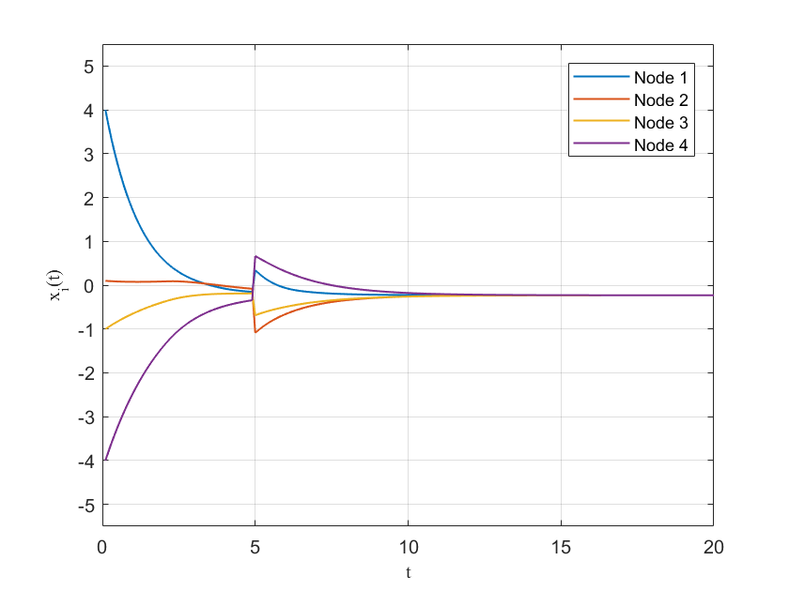
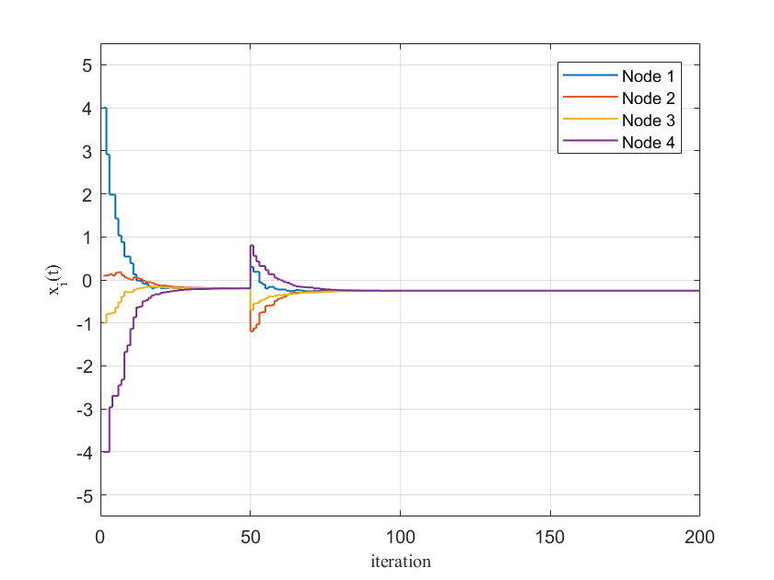
5. Comment—Advantages
1. Give an theoretical guide to design a system with consensus
2. Robustness
Deterministic
Random
Notes:
1 自顶向下的设计，有了需求之后就可以知道我的内部的节点可以设置的范围
2 抗干扰

Slide 18
5. Comment—Drawback
For length of interaction of intervals > 0.
This system is asymptotically stable outside the intersection of the allowed consensus intervals, because of the saturations, but marginally stable inside it.
Disturbance
Deterministic

Slide 19
Thanks!

